Slide 1
WEGROWBIZ.ORG

Slide 2
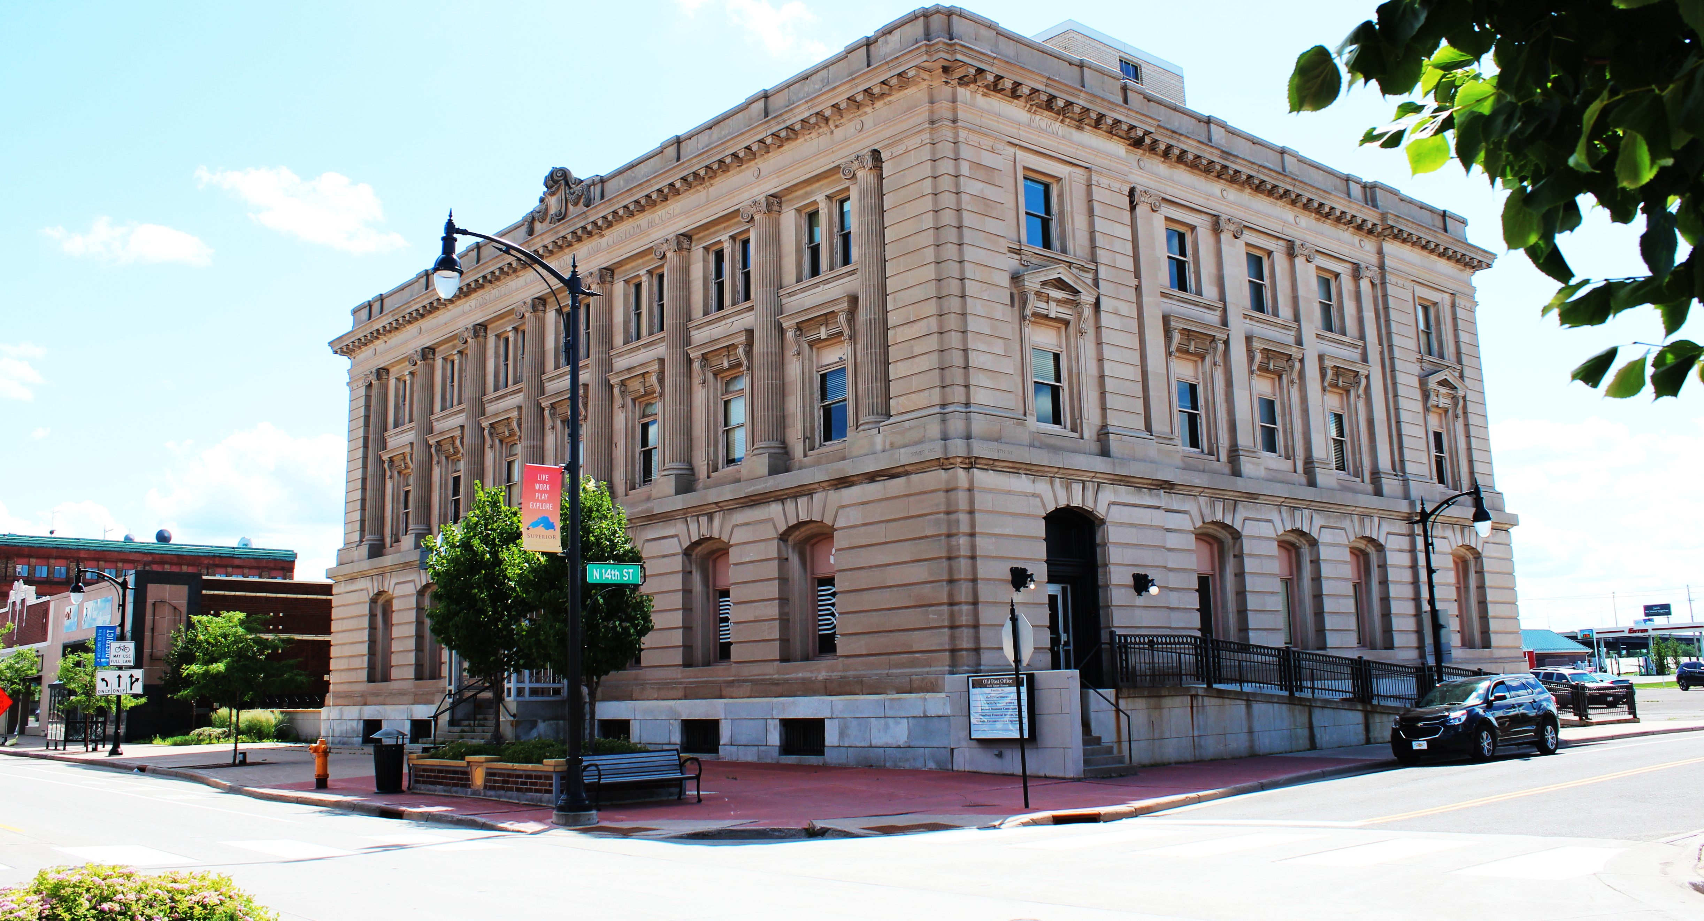
OUR MISSION STATEMENT
The mission of the Development Association is to champion business growth, creation, recruitment and retention in the City of Superior and Douglas County. Through the support of its members, it encourages entrepreneurship and assists business start-ups, while making it a priority to determine the needs, threats and opportunities facing existing businesses. The Association has been established as a key economic driver in the region, helping businesses navigate their way, in the often-uncharted business landscape with its connections in the private and public sectors. Big or small, old or new, the Development Association offers services that are essential to all kinds of businesses, making sure the gears of business continue moving forward.

Slide 3
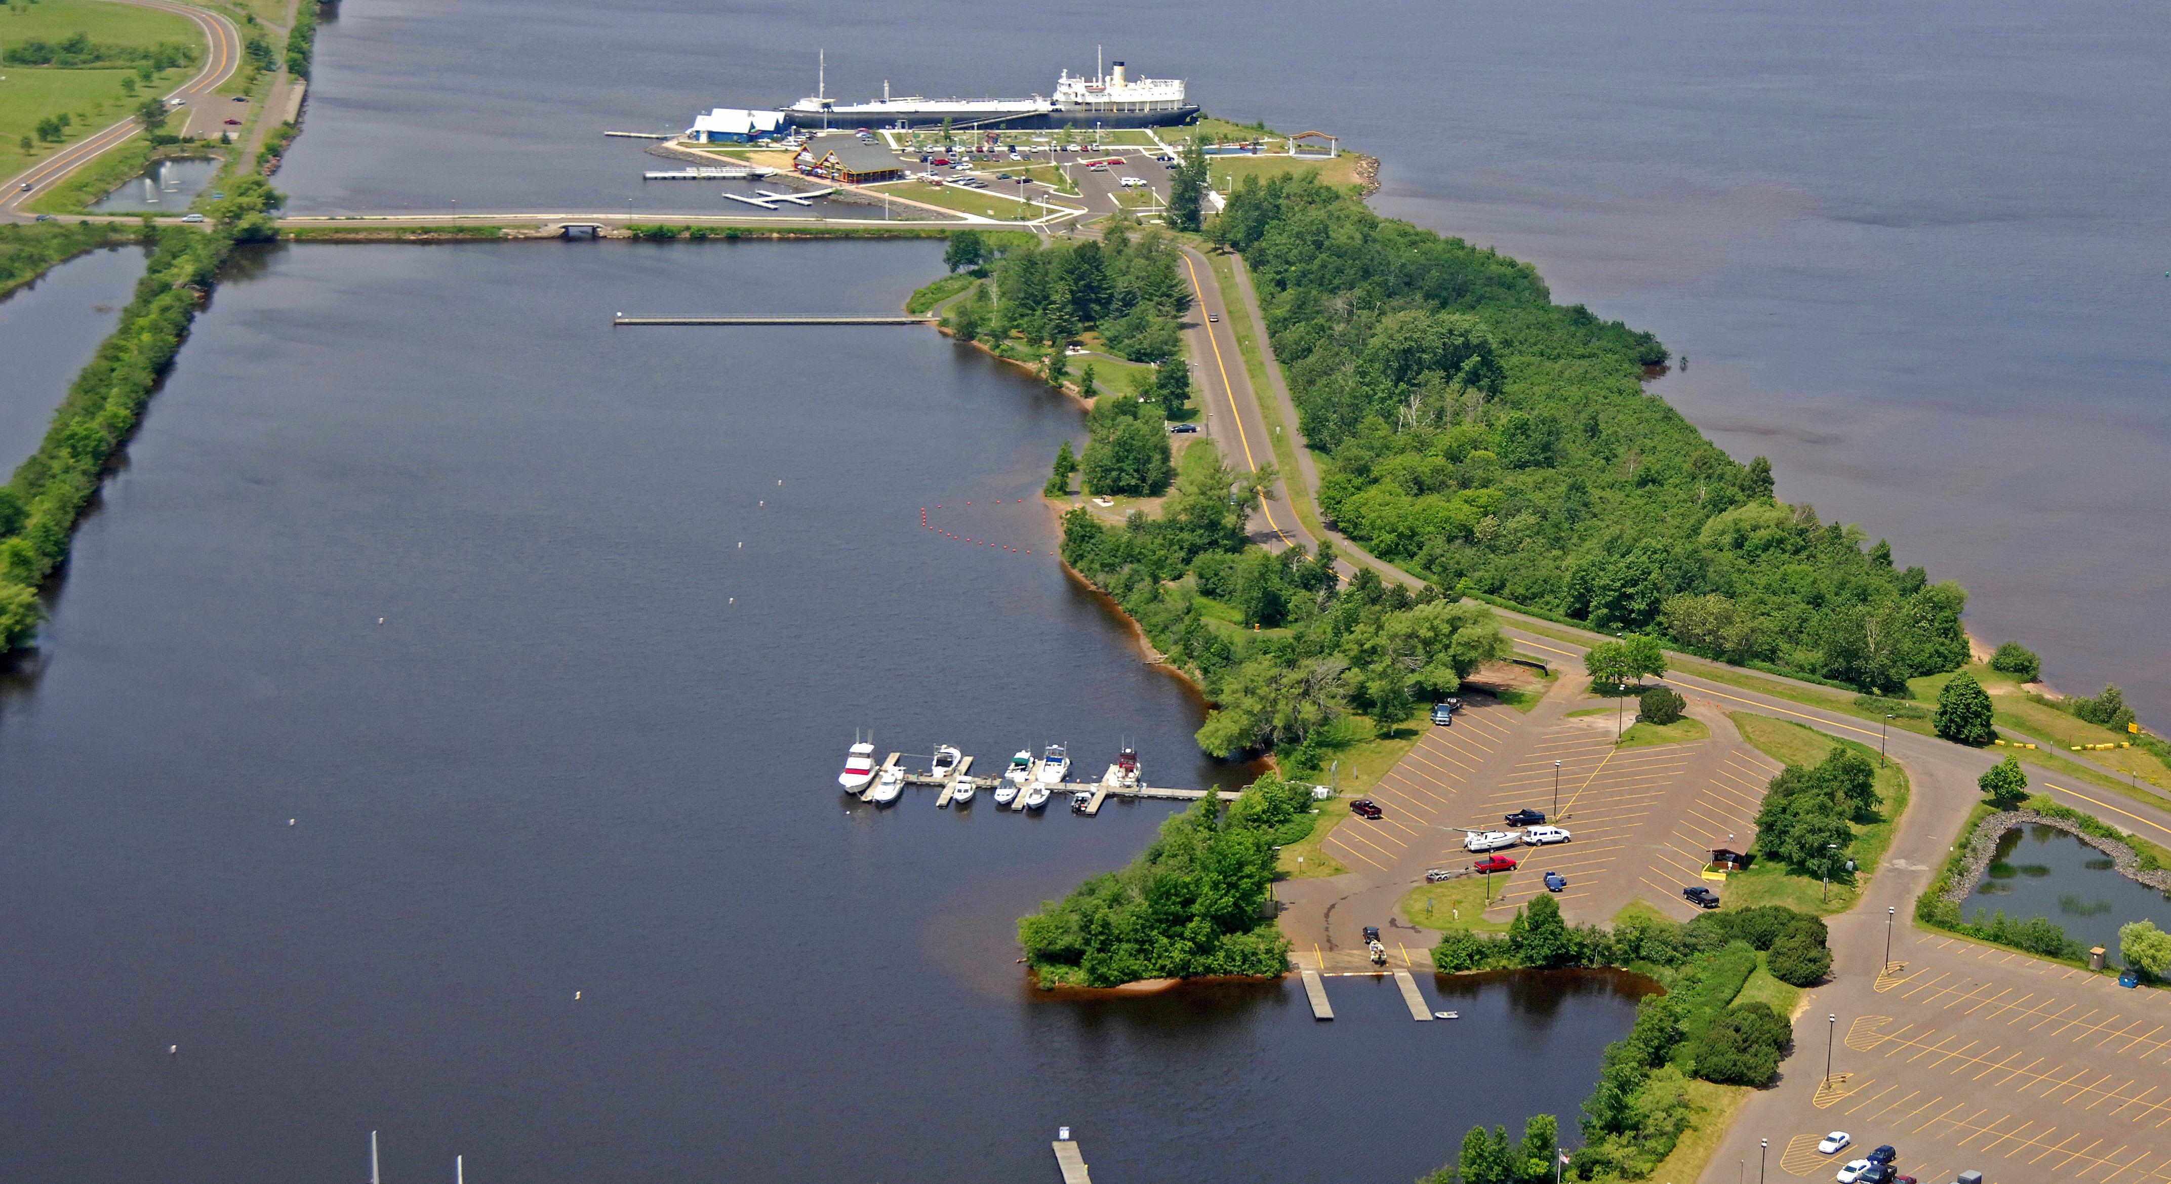
Superior
Waterfront
Images

Slide 4
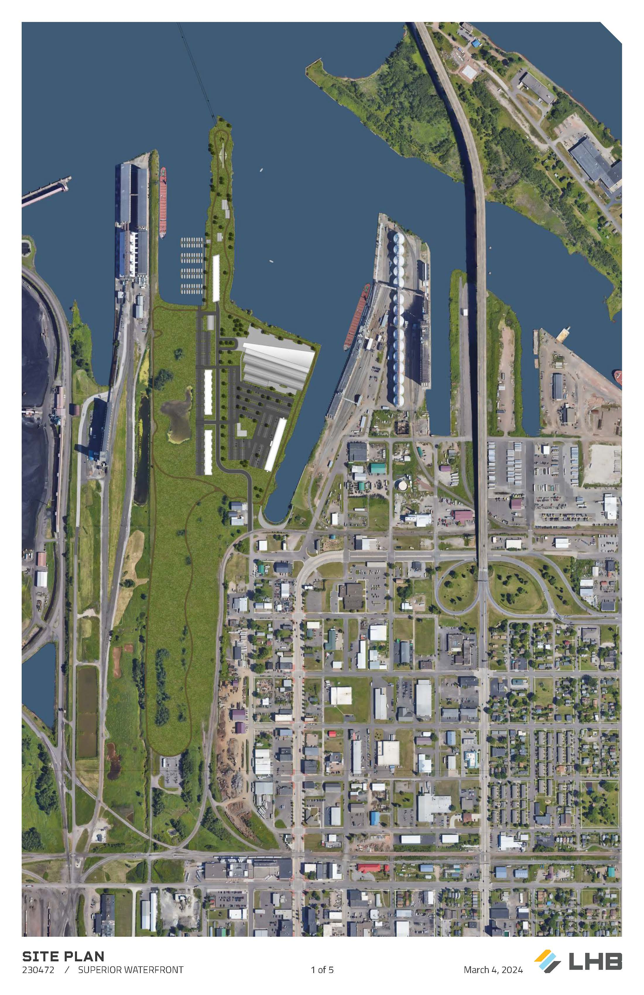

Slide 5
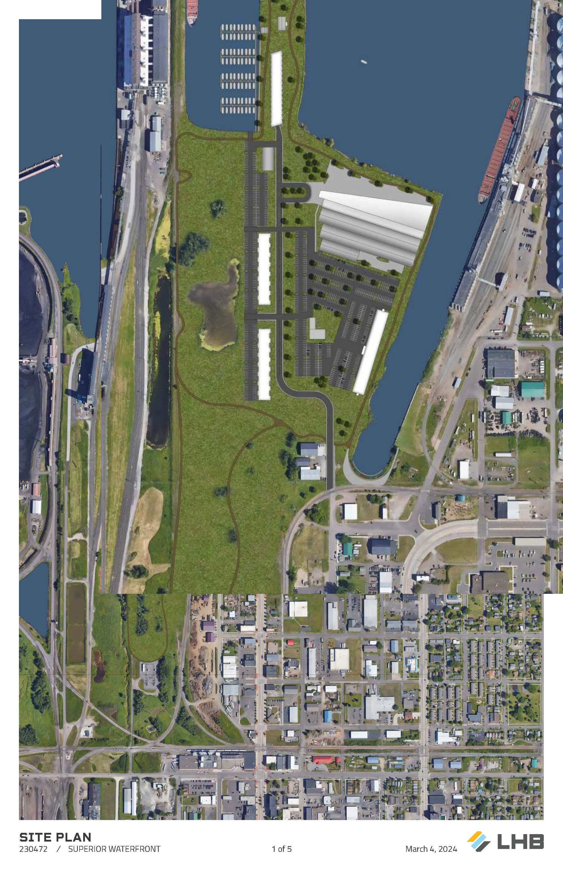

Slide 11
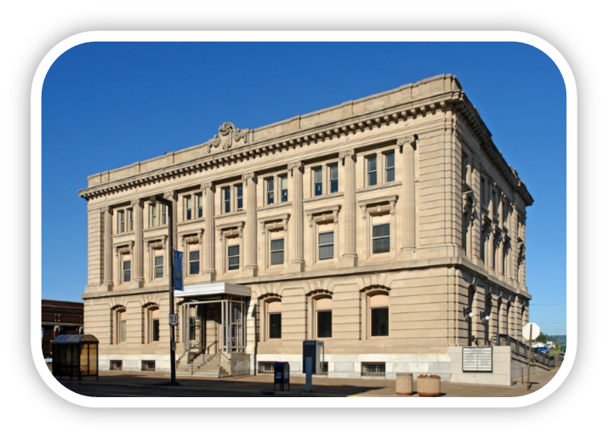
1401 Tower Avenue

Slide 12
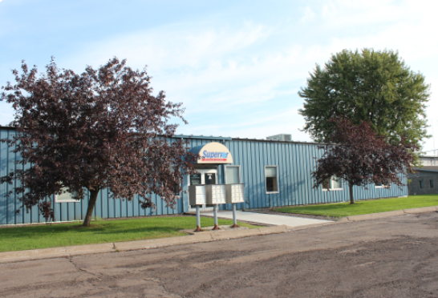
1423 N. 8th Street

Slide 13
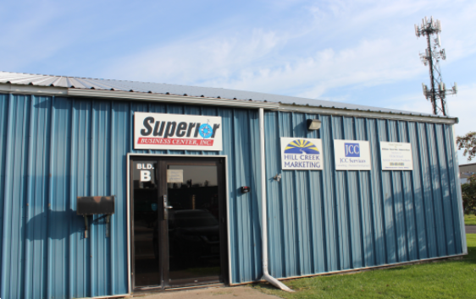
625 Hughitt Avenue

Slide 14
MEMBERSHIP LEVELS

Slide 15
PREMIER

Slide 16
LEADER

Slide 17
ADVOCATE

Slide 18
SUPPORTER
^{1320 Belknap, LLC}
^{A1 Movers}
^{A2D2}
^{Align Yoga}
Anderson & Hammack Construction
^{Arco Coffee Company}
^{Arrow Manufacturing}
^{Arrowhead Printing} ^{Artistic Florals by Leslie} ^{Barkers Island Inn}
^{Belknap Liquor & Lounge}
^{Belknap Plumbing & Heating Co.}
^{Bell Bank}
^{Benna Auto Center}
^{Big Apple Bagel}
Brad Theien Appraisals & Consulting
^{Call Center Resources}
^{Campbell Lumber} Catholic Charities Bureau-Housing
^{Central Sheet Metal Works Inc.}
Centricity Credit Union Superior
^{Challenge Center} ^{Chippewa Valley Bank}
^{Coordinated Business Systems}
^{Core Landscaping}
^{Creative Cats}
^{Dahlberg Light & Power}
^{discoverpc.NET}
^{DMB Morales, LLC}
^{Dorfman Company} ^{Downs Funeral Home} ^{DSC Communications}
^{Duluth Airport Authority}
^{Duluth Seaway Port Authority} Earth Rider Brewery/Cedar Lounge
^{Embark Supported Employment}
^{Encore Events & Party Express}
^{Entrepreneur Fund}
^{Enviro Tech Services, Inc.} Environmental Consulting & Testing, Inc.
Esterbrooks, Scott, Signorelli, Peterson, ^{Smithson, LTD}
^{Field & Connolly LTD}
^{Fiero Aero, LLC}
Financial Recovery Services, Inc.
^{Frandsen Bank & Trust}
^{Fraser Industries LLC}
^{Fritsche Haskins Enterprise}
Fryberger, Buchanan, Smith, and Frederick
^{Great Lakes Office Solutions}
Greg Follmer Commercial Real Estate
Guardian Pest Control Solutions
^{Hammond Liquors}
^{Hill Creek Marketing}
^{Holden Insurance}
^{Holiday Inn Express & Suites}
^{IHS Door Company}
^{In Response Gaming}
^{J B Building, LLC}
^{J R Jensen Construction}
^{JCC Services}
^{Jeff Foster Trucking}
^{Johnson Insurance Consultants}
^{Kari Toyota} ^{Keyport of Superior}
^{Kyle J Chmielecki/AFLAC}
^{Ledin, Olson & Cockerham}
^{Mariner Business Center}
^{Market Beautiful} ^{Mediqwest Insurance}
^{Nelson Oil Enterprises} ^{Nextera Communications, LLC}
Nick Korhonen American Family Insurance
^{North Bay Trading Company}
^{North Shore Bank}
Northland Financial Planning Services, LLC ^{Northland Foods, Inc.}
^{Northspan Group, Inc.}
^{Northwest Outlet} Northwest Regional Planning Commission
^{Northwood Technical College}
^{P&R Properties}
^{Paul Davis Restoration}
^{Positively Superior, LLC}
^{Pottery Burn}
^{Professional Portable X-Ray}
^{Randy’s Carpet Cleaning, LLC}
^{Rascals}
^{Rooted in Wellness}
^{Sailboats, Inc.}
^{Sanco Supply, Inc.}
^{Saratoga Liquor Company} ^{School District of Superior}
Screen Graphic/Uniform Connection
^{Sportsman’s Marketing, Inc.}
^{Stormwerkz Corporation} ^{Strength Factory} ^{Superior Business Center} Superior Business Improvement District
^{Superior Effect Marketing}
Superior Douglas County Chamber of Commerce
Superior Floor Care Specialists
^{Superior Housing Authority}
Superior Lawn & Cleaning Services
^{Superior Lidgerwood Mundy}
^{Superior Waffles}
^{The Strength Factory}
^{Thirsty Pagan}
^{Torvinen, Jones & Routh S.C.}
^{Twin Ports Custom Climate}
^{Udeen Trucking, Inc.} University of Wisconsin Superior
^{Vahtii Tech, LLC}
^{VC3}
^{Village of Solon Springs} ^{Wabegon Bar & Grill, LLC}
^{Wildflower Bicycles}
^{Wilson Development}
^{Wipfli, LLP}
^{World of Wheels}
^{Zia Properties}

Slide 19
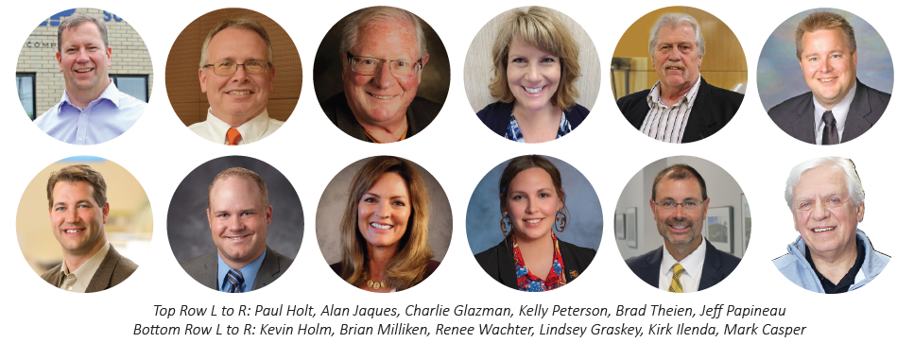
The development association
2024 BOARD OF DIRECTORS

